Slide 1
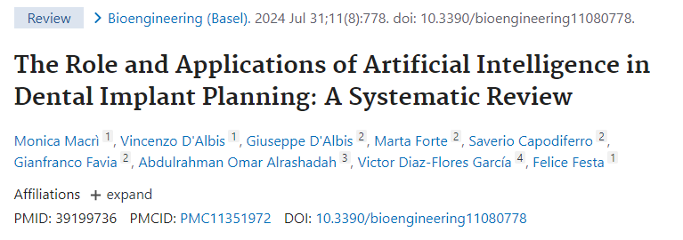
Review AI-implant planning
https://www.ncbi.nlm.nih.gov/pmc/articles/PMC11351972/
Segmentare automata a crestei alveolare (Moufti et al.), dinti
Segmentare canal mandibular, sinus maxilar
Planning – missing tooth detection, bone height measurements and bone thickness measurements (Bayrakdar et al), implant drilling protocol (Sakai et al)
System to analyze various patient statistics to predict the success of single implant survival (Lyakhov et al)

Slide 2
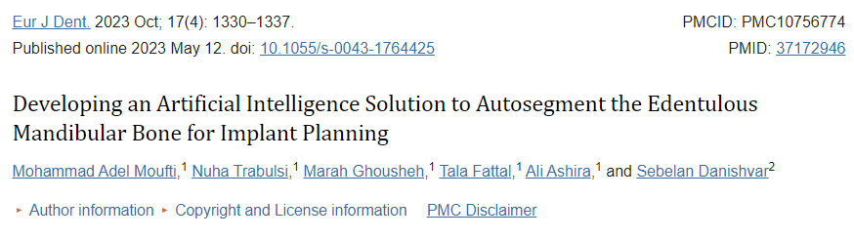
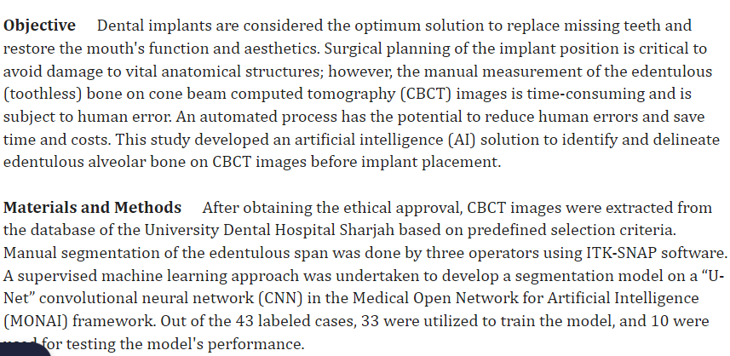
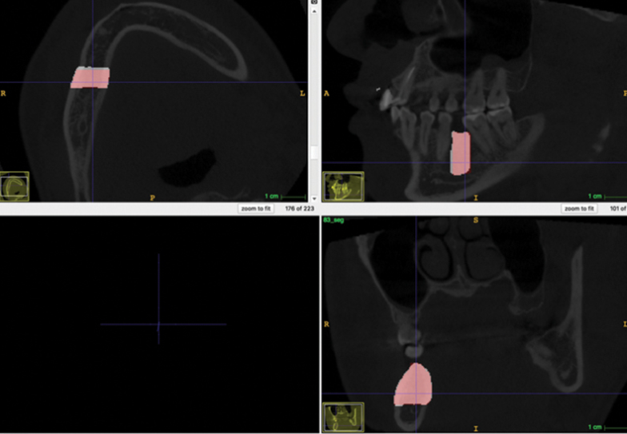
Segmentare creasta edentata CBCT
https://www.ncbi.nlm.nih.gov/pmc/articles/PMC10756774/

Slide 3
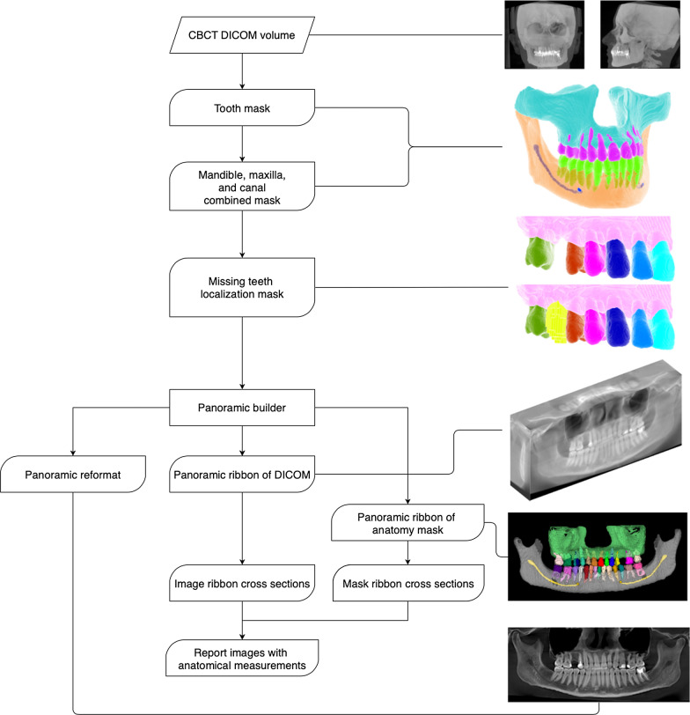
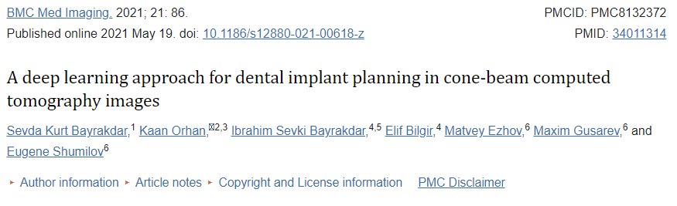
Planning-measurements
DiagnoCAT validare
https://www.ncbi.nlm.nih.gov/pmc/articles/PMC8132372/

Slide 4
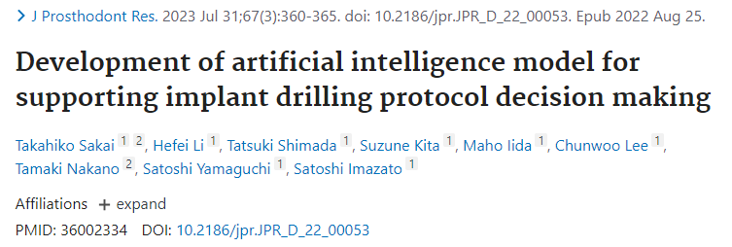
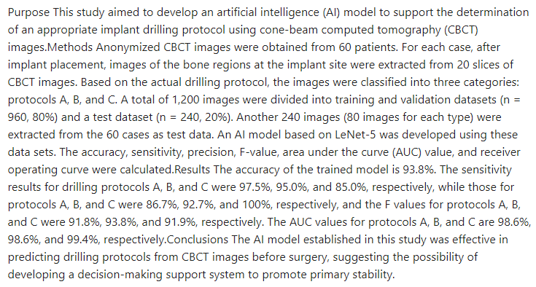
Implant drilling protocol
https://pubmed.ncbi.nlm.nih.gov/36002334/

Slide 5
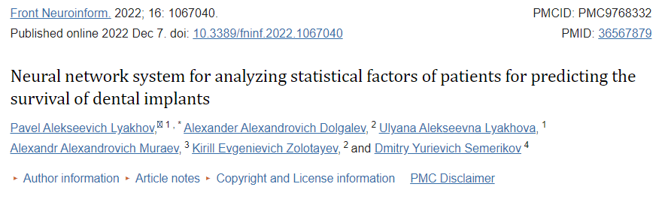
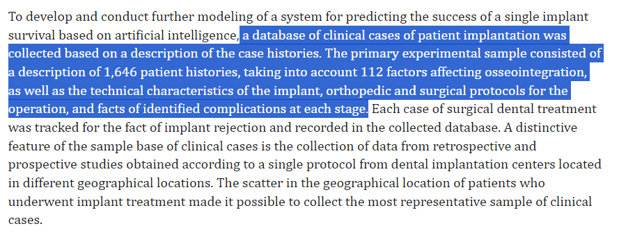
Implant failure prediction
https://www.ncbi.nlm.nih.gov/pmc/articles/PMC9768332/

Slide 6
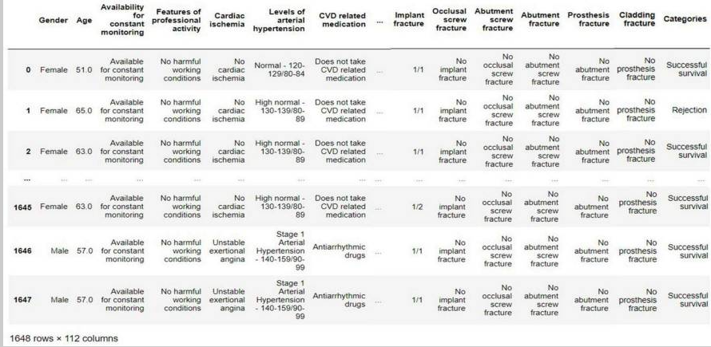
Implant failure prediction

Slide 7
Baze de date publice
Rx panoramice cu dintii segmentati
https://github.com/IvisionLab/OdontoAI-Open-Panoramic-Radiographs/blob/main/README.md
CBCT-uri cu segmentari dinti
https://github.com/liangjiubujiu/CTooth
Electronic dental records BigMouth
https://www.uth.edu/bigmouth/

